Slide 1
Interpolation of Structure Factors
SHUG-15
Jose M. Borreguero & Vickie E. Lynch
Neutron Data Analysis and Visualization Division
Center for Accelerating Materials Modelling

Slide 2
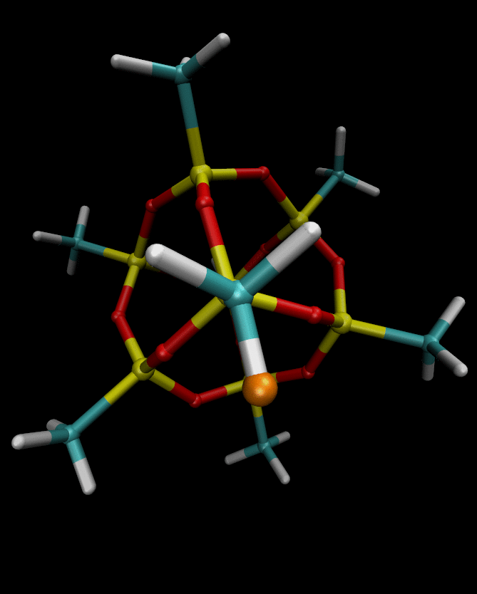
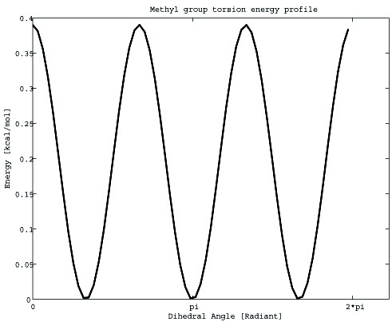
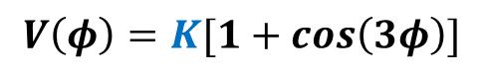
Goal
Obtain dihedral potential barrier ot Methyl rotations that optimizes comparison between experimental and simulated S(Q,E)
Methyl Rotations
$$V\left(φ\right)=K[1+cos\left(3φ\right)]$$
2K

Slide 3
Simple refinement strategy
We aim to refine a single parameter
Diffusion is highly sensitive to the dihedral barrier
Simple strategy: Perform a series of simulations in a range of parameter values, each with a fixed value of force-field parameter K.
K
K₁
K₂
K₃
K*
K_{n}
Optimal value to be found
Main advantage: simulations are run in parallel ( take less than a day )

Slide 4
Refinement Workflow
K
Remote cluster
Local Workstation
K_{N}
EQUILIBRATION
PRODUCTION
N simulations
I_{i}
S_{i}
S
S
(
(
(
(
Q, t
Q, E
Q, E,
K
Q, E,
K*
(
(
(
(
K₂
K₁
A
B
C
Molecular
Dynamics
Intermediate Scattering law
A:
Scattering Law
B:
Smoothing/Interpolation
C:
Optimization→ yields K*

Slide 5
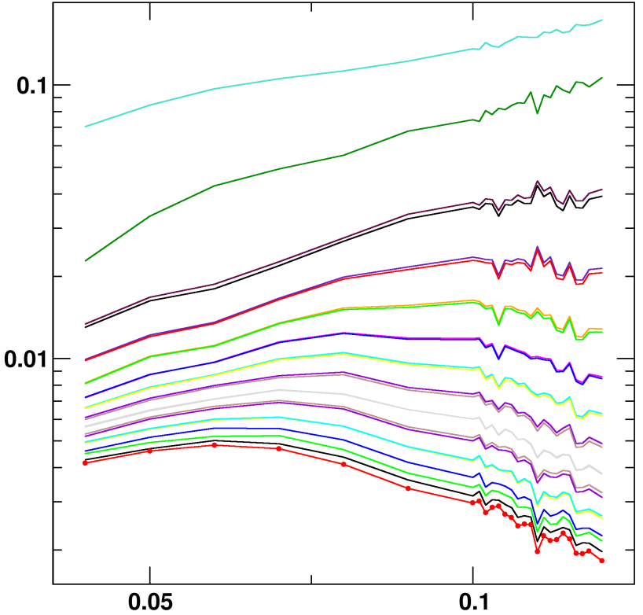
The Sampling Problem
Observation: Molecular Dynamics (MD) simulations are finite in time and size.
Consequence: Errors in the correlation functions
Simulation-derived scattering laws are not smooth
0.10meV
Q=0.9Å⁻¹
0.09meV
S( K | Q,E )
-0.11meV
-0.12meV
K (Kcal/mol)
-0.13meV

Slide 6
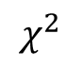

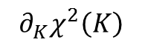
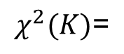
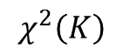
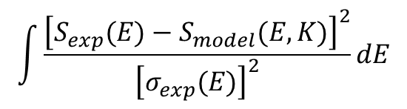
The Sampling Problem
Why do we care?
Errors produce a rugged landscape in
is ill defined
Minimization of will get stuck in a
(false) local minimum.
$$\int{\frac{{\left[S_{exp}(E)−S_{model}(E,K)\right]}^{2}}{{\left[σ_{exp}(E)\right]}^{2}}dE}$$
$$χ^{2}$$
$$χ^{2}(K)\text{=}$$
$${∂_{K}^{}χ}^{2}\left(K\right)$$
$$χ^{2}\left(K\right)$$
$$K$$

Slide 7
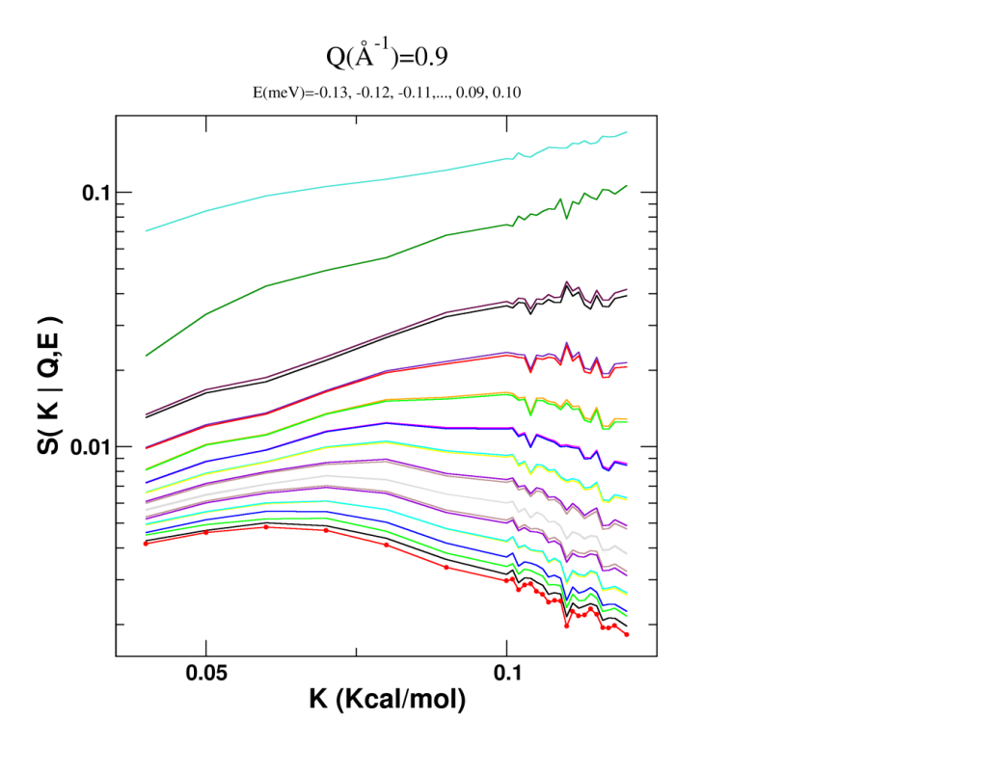
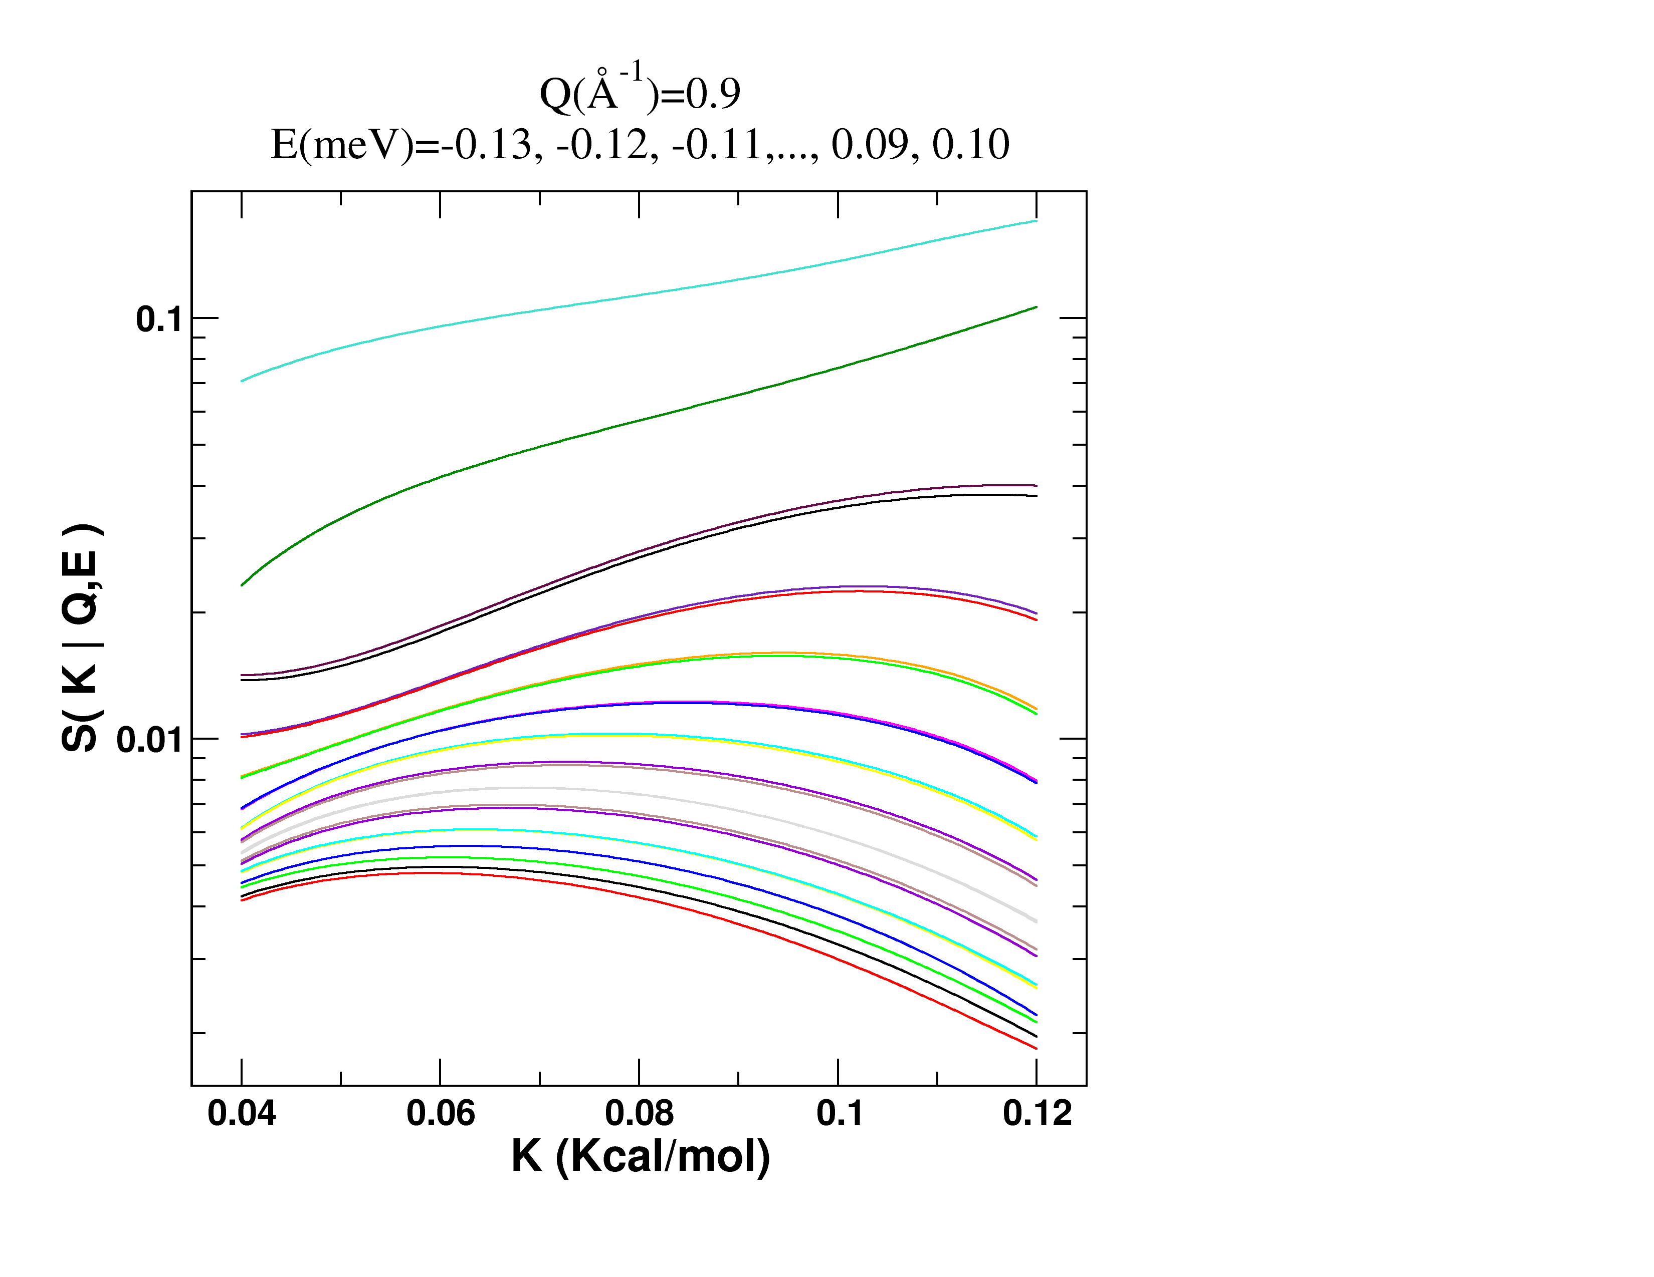
Solution : Generate an Interpolator
S(K,Q,E) is smooth and derivable, like an analytical model
In Mantid:
Algorithm Dsfinterp
Fitting function DSFinterp1DFit
S( K | Q,E )
S( K | Q,E )
K (Kcal/mol)
K (Kcal/mol)

